Slide 1




Roundtable introduction
WELCOME!
@EcoCommonsAus
Species Distribution Modelling in R
Step 3: fitting your model
Dr Rob Clemens (he/him)
Change & Communications E: comms@ecocommons.org.au
T: @EcoCommonsAus
@RobertSClemens1
Notes:
Welcome to the workshop: Using the BCCVL to solve environmental problems, brought to you by the EcoCommons program
Firstly, as we gather for this workshop dispersed across many physical locations, I would like to take a moment to acknowledge the various traditional owners of the lands on which we meet, including the the Traditional Custodians of the ACT, the Ngunnawal people where I am today. I acknowledge the Elders – past, present and emerging of all the lands that we work and live on, and recognise their extraordinary contributions to the cultural, economic and scientific domains that we will discuss today.

Slide 2
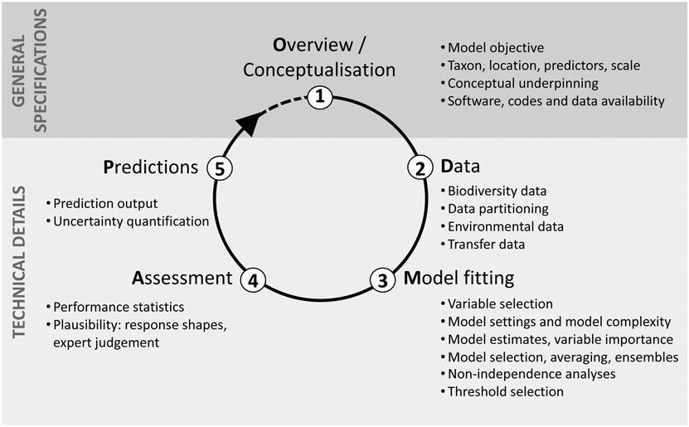
Overview of the process
Zurell, et. al.(2020), A standard protocol for reporting species distribution models. Ecography, 43: 1261-1277. https://doi.org/10.1111/ecog.04960

Slide 3
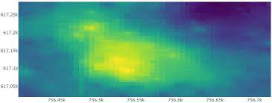




Geographic
models
+
Geographic models
+
+
+
+
+
+
+
+
latitude
+
+
+
+
+
longitude
Presence only
No environmental data
Inverse Distance weighting
Notes:
Geographic models only use presence data, and no environmental data(C). The models use simple algorithms that predict that a species is present at sites within a certain shape or distance around the occurrence points (C). An example is the convex hull model that draws a shape around the outermost occurrence points (a convex hull) and predicts that a species can be present anywhere within the convex hull, and will be absent outside the convex hull. Because geographic models do not take into account the environmental conditions of occurrence sites, they are often not considered as true species distribution models. But they provide a good method to get a quick idea of the spatial extent of a species.

Slide 4


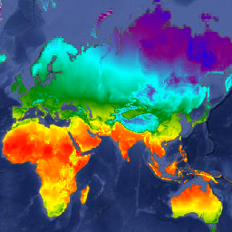
Bioclim
Profile
models
v1 min
v1 max
Profile models
+
v2 max
+
+
+
+
+
+
+
+
+
+
Environmental variable 2
+
+
+
+
+
+
+
+
+
+
+
Presence only
v2 min
Need environmental data
Environmental variable 1
NOTES
> continuous variables only
> no interactions
https://developers.google.com/earth-engine/datasets
Notes:
Profile models are the most basic true species distribution models. Like geographic models, they also use only occurrence data, but these models do use environmental data as well. The best known profile method is Bioclim (C) which is considered as the first species distribution model. Bioclim constructs the suitable environmental space as a bounding box around the minimum and maximum values of the environmental variables for all occurrences (C). The green area (C) within the bounding box represents the suitable environmental conditions for a species to survive. With multiple variables, this results in a multi-dimensional rectilinear envelope ((C)
Profile models can only handle continuous predictors, and do not take into account interactions between environmental variables.

Slide 5
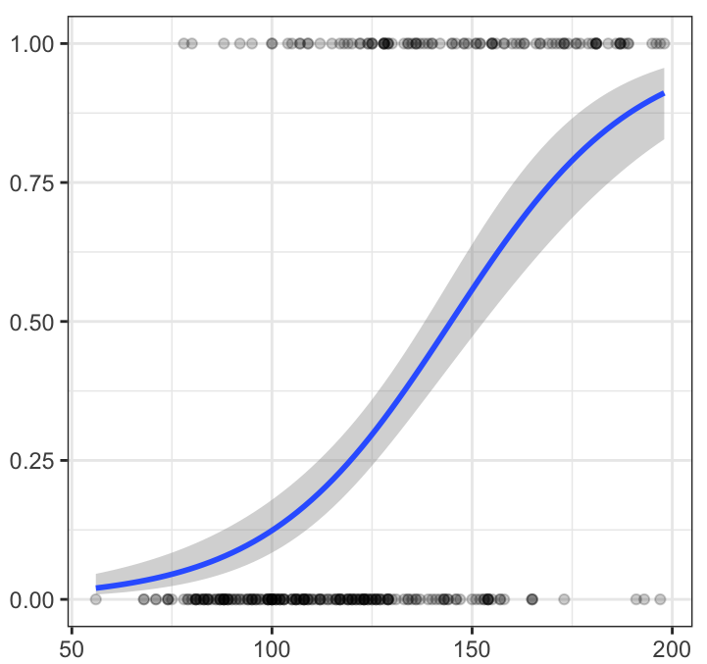
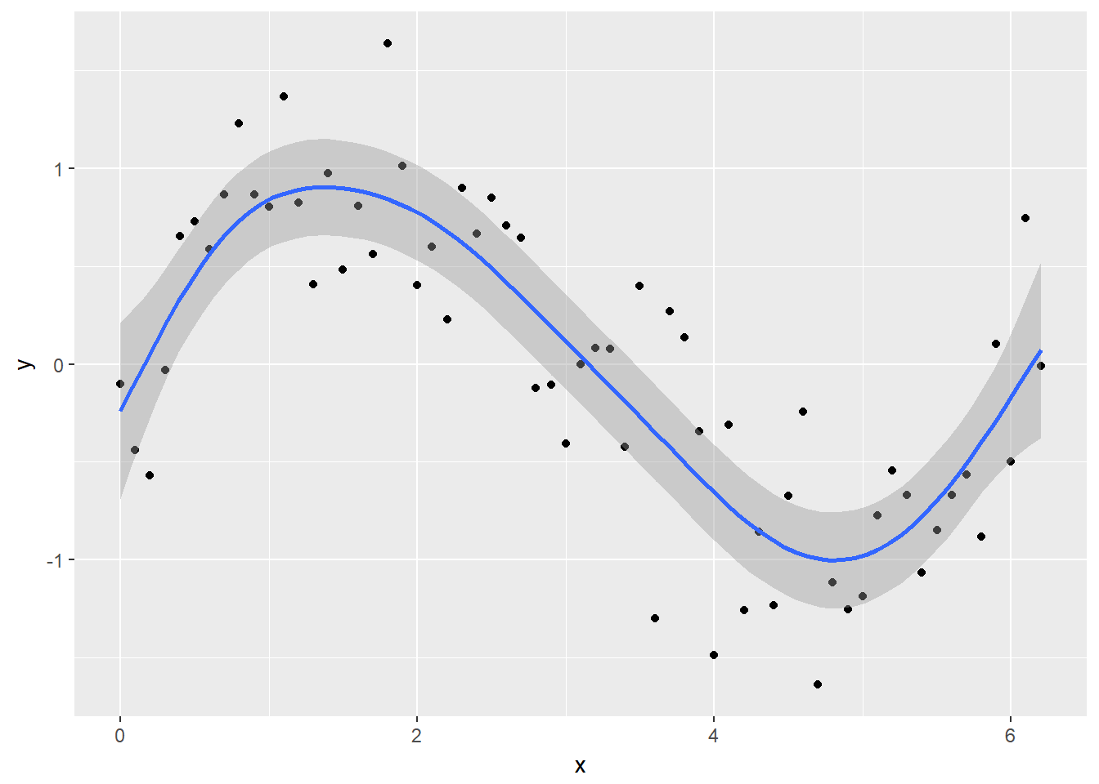
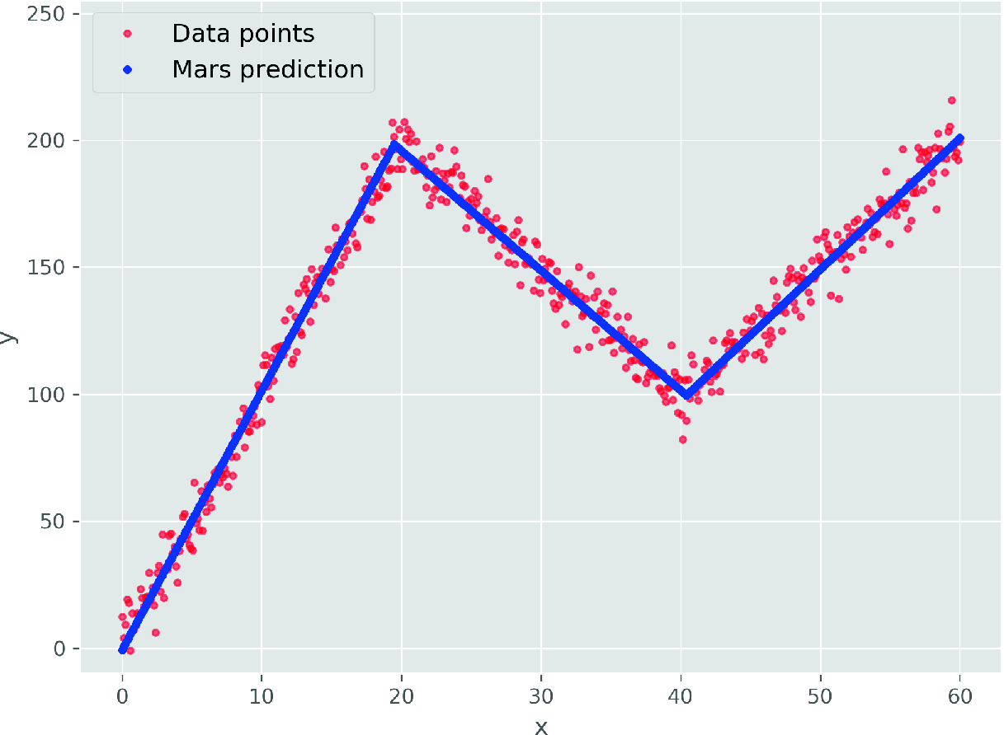
Binomial GLM
Best for explanation / inference
Need a response variable. Presence and (pseudo)absence response variable, or abundance
Continuous & categorical environmental predictors
Geographic models
http://www.sthda.com/english/articles/36-classification-methods-essentials/151-logistic-regression-essentials-in-r/
Statistical
models
Multivariate Adaptive Regression Splines
Generalized Additive Model
Knot
Shen & Wang (2020) https://doi.org/10.1007/978-3-030-32029-4_27
http://environmentalcomputing.net/intro-to-gams/
Notes:
Statistical regression models need both presence and absence data. These models also use environmental data, and the algorithms use all the data available to estimate the coefficients of the environmental variables, and they construct a function that best describes the effect of those variables on species occurrence. Statistical regression models can handle both continuous and categorical predictors and also include interactions between those variables. Three popular statistical algorithms for species distribution modelling are generalized linear models, generalized additive models and multivariate adaptive regression splines.

Slide 6
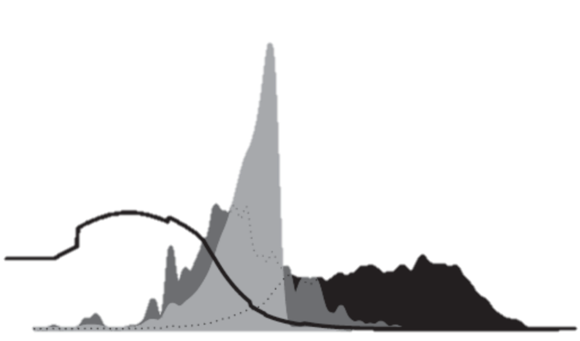
> presence background
Probability density
Often best at prediction
Need environmental data
Maxent
Environmental variable
Merow et al. 2013
> presence & (pseudo) absence
Tree-based models
0
1
0
0
0
1
> presence & (pseudo) absence
Machine learning models
Artificial Neural Networks
Notes:
The last group is machine learning models, which also use environmental data. While statistical models use all data to build the function, machine learning models typically train the model on one part of the dataset and the other part to assess the accuracy of the model. Most machine learning models use both presence and absence data, but there is one exception.
This is Maxent, which predicts species occurrences by finding the distribution that is most spread out, or the closest to uniform, while taking into account the limits of the environmental variables of known locations.
Then we have tree-based models, which predict species occurrence probabilities based on decision trees, and the last machine learning model available in the BCCVL are artificial neural networks.

Slide 7
Machine Learning
Maxent
Great at predicting, well developed framework especially when absence data are lacking
Works with presence only data
Random Forest
Great when complex interactions are suspected, and when you have large numbers of predictor variables
Nearly identical to random forest unless there are some areas that are tough to predict into as BRT focuses on improving the model in areas of poor performance. If those areas are location errors, or unimportant outliers BRT can overfit training data by focusing on unrepresentative data.
Boosted Regression Tree
Tree based models are often better in simple SDM problems but if there are highly complex spatial and environmental variation ANN is better, require large volumes of data
Artificial Neural Network
Notes:
Firstly, the data that you have available or want to use might limit some of your options.
(C) If you don’t have any environmental data available or the environmental data is not appropriate for your species, you are limited to a geographical model, which mostly gives just an indication of the range of a species.
(C) If you do have data on environmental conditions, then you can design a true species distribution model.
(C) The next step is to look at the availability of your species data.
(C) If you only have presence data, you can choose to run a simple profile model, such as Bioclim.
(C) An alternative if you only have presence data, is Maxent, which is a presence-background model that contrast the environmental conditions of presence locations with all available locations.
(C) Alternatives to presence only and presence-background models are presence-absence models with either true absence or pseudo-absence data. These can either be statistical or machine learning models.

Slide 8

Model fitting
Notes:
There is a variety of different outputs that your species distribution model will produce that you can use to draw conclusions about the distribution of your species.
You can check the predictive performance of the model with a whole bunch of so-called evaluation statistics. But before you look at the stats, it is always good to
to do a reality check of the visual outputs such as the predicted distribution map and the response curves of the environmental variables.
Let’s have a look at those first.

Slide 9

Variable / model selection
Reduce multicollinearity to make sense of models ecologically – critical in statistical methods
Remove unimportant variables - Parsimony - Keep the model as simple as possible
Sensitivity analysis, how sensitive are results to model arguments
Model averaging often results in better predictions
(model outputs, spatial averaging, averaging temporal predictions, average across species)
Notes:
Each of the algorithms have their own assumptions and limitations with regards to the input data.
As I mentioned earlier, (C) profile models are not able to include categorical predictors or interactions. They generally show poorer performance compared to presence-absence or presence-background models.
(C) Statistical models tend to be more sensitive to outliers and missing data compared to the machine learning models.
(C) But machine learning models are more sensitive to overfitting the data. (C) MaxEnt has an inbuilt process to avoid overfitting.
An advantage of machine learning models, though, is that they (C) are able to handle large datasets. (C) However, if you don’t have many occurrence points available, MaxEnt or a statistical model might work better.
Keep in mind that this guide is not exclusive, and in general it is advised to run multiple models and compare their outcomes.

Slide 10
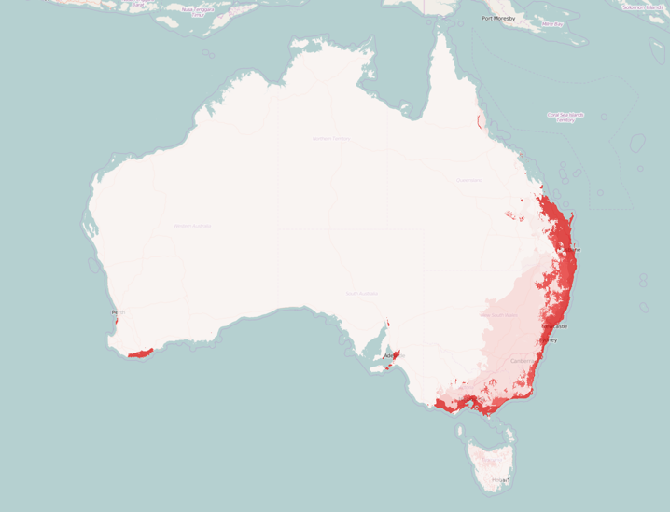
Threshold selection
Probability of presence (continuous)
Categorical prediction: present/absent
1 (high)
Maximise the sum of sensitivity plus specificity often works best
Present
0.5
threshold
Absent
0 (low)
Notes:
Most algorithms produce this probability score as a continuous response ranging from 0, which represents low probability of presence to 1, which refers to a high probability of presence.
To calculate the evaluation statistics, these probabilistic predictions (C) are commonly converted to a categorical prediction, which means that for any given point it is predicted whether a species could be present or absent.
This conversion is based on (C) a threshold value of the probability prediction.
By convention, this threshold is often set at (C) 0.5, which means that for each location with a probability above 0.5, (C) the prediction is positive, thus the species is present, and locations with a probability below 0.5 (C) are predicted to be negative, thus the species is absent.
However, there are a lot of different methods for selecting the threshold value depending on factors such as the overall error pattern of the model and the ratio of presence vs absence points.

Slide 11

Step 3: Fit your model
Maxent example
BRT example
BRT tuning
GLM exmample
GAM example
Notes:
However, if you look up a distribution map of a species, it often shows a range rather than dots on a map. So, how do we go from specific places where individuals of a species have been observed to producing a map that gives an estimate of the distribution of that species? This is where species distribution models come into play.

Slide 12
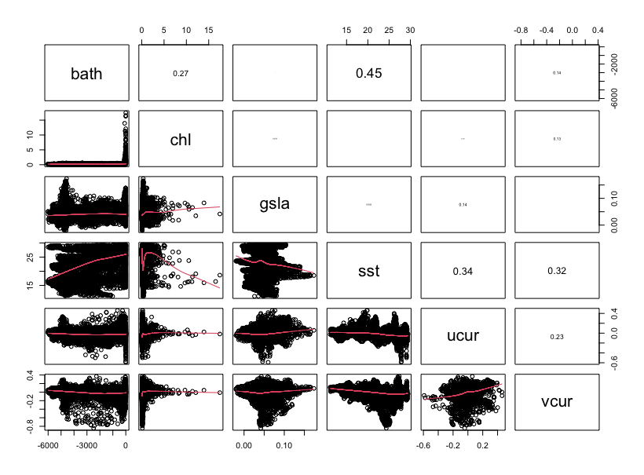
Step 3: Fit your model (correlation between predictors)
Check for correlation in your environmental variables
panel.cor <- function(x, y, digits=2, prefix="", cex.cor, ...)
{
usr <- par("usr"); on.exit(par(usr))
par(usr = c(0, 1, 0, 1))
r <- abs(cor(x, y, use="pairwise.complete.obs"))
txt <- format(c(r, 0.123456789), digits=digits)[1]
txt <- paste(prefix, txt, sep="")
if(missing(cex.cor)) cex.cor <- 0.8/strwidth(txt)
text(0.5, 0.5, txt, cex = cex.cor * r)
}
rpoints<-randomPoints(LiPe_predictors,1000)
samp<-extract(LiPe_predictors,rpoints)
pairs(samp,lower.panel=panel.smooth,upper.panel=panel.cor)
Notes:
However, if you look up a distribution map of a species, it often shows a range rather than dots on a map. So, how do we go from specific places where individuals of a species have been observed to producing a map that gives an estimate of the distribution of that species? This is where species distribution models come into play.

Slide 13

Step 3: Fit your model (presence data, mask, extent)
x_LiPe<- LiPe_thinned$decimalLongitude
y_LiPe<-LiPe_thinned$decimalLatitude
xy_LiPe<-cbind(x_LiPe,y_LiPe)
xy.sp_LiPe<-SpatialPoints(xy_LiPe)
crs(xy.sp_LiPe) <- crs(LiPe_predictors)
crs(xy.sp_LiPe)
mask_r <- LiPe_predictors[[2]]
ext <- raster::extent(LiPe_predictors)
Notes:
However, if you look up a distribution map of a species, it often shows a range rather than dots on a map. So, how do we go from specific places where individuals of a species have been observed to producing a map that gives an estimate of the distribution of that species? This is where species distribution models come into play.

Slide 14
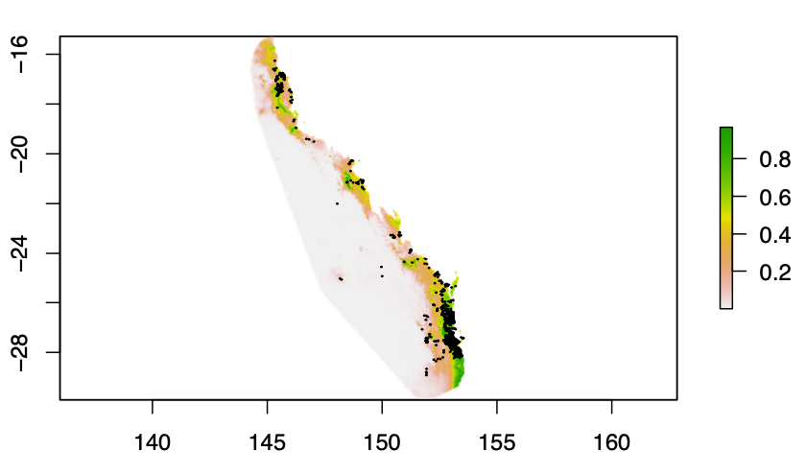
Step 3: Fit your model (Maxent, 10,000 random for background)
maxent_args <- c('removeduplicates=TRUE', 'jackknife=TRUE', 'responsecurves=TRUE', 'plots=TRUE')
Mod1_LiPe <- dismo::maxent(LiPe_predictors, xy.sp_LiPe, path = "results", args= maxent_args)
map_predictions <- predict(Mod1_LiPe, LiPe_predictors, args=maxent_args)
plot(map_predictions)
points(xy.sp_LiPe,pch=20,cex=0.2)
require("jpeg")
setwd("~/Documents/Use_cases/SDM_in_R")
jpeg(paste0(getwd(),"/results/LiPe_predicted.jpeg"))
plot(map_predictions)
points(xy.sp_LiPe,pch=20,cex=0.2)
dev.off()
Notes:
However, if you look up a distribution map of a species, it often shows a range rather than dots on a map. So, how do we go from specific places where individuals of a species have been observed to producing a map that gives an estimate of the distribution of that species? This is where species distribution models come into play.

Slide 15
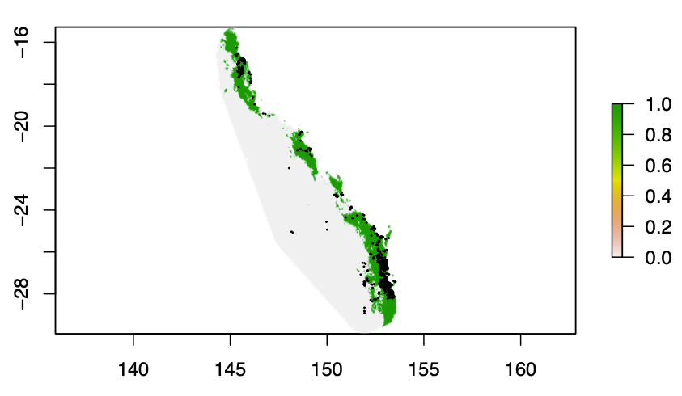
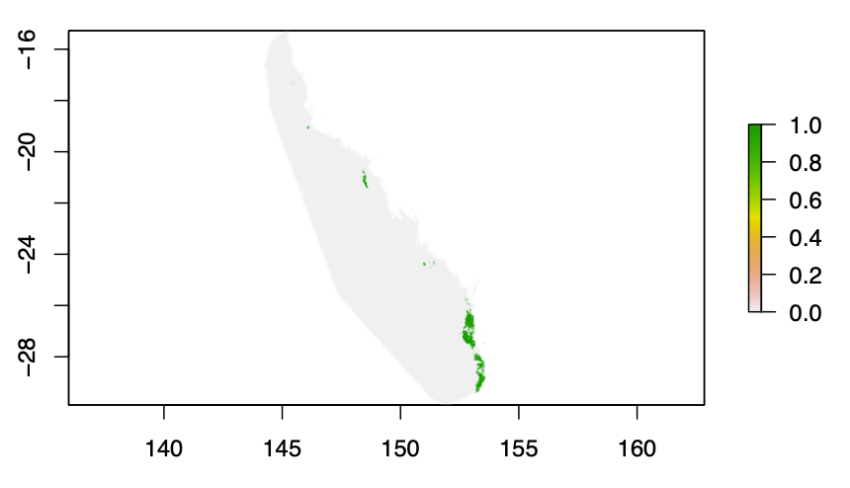
Step 3: Fit your model (thresholding to get presence / absence map)
thresh<-results1$Maximum.training.sensitivity.plus.specificity.area
m <- c(0, thresh, 0, thresh, 1, 1)
reclass <- matrix(m, ncol= 3, byrow= TRUE)
rc <- reclassify(map_predictions, reclass)
plot(rc)
min.R <- cellStats(map_predictions,"min")
max.R <- cellStats(map_predictions,"max")
map_predictions2 <- ((map_predictions - min.R) / (max.R - min.R) - 0 ) * 1
thresh2 <- 0.8
m2 <- c(0, thresh2, 0, thresh2, 1, 1)
reclass2 <- matrix(m2, ncol= 3, byrow= TRUE)
rc2 <- reclassify(map_predictions2, reclass2)
plot(rc2)
Notes:
However, if you look up a distribution map of a species, it often shows a range rather than dots on a map. So, how do we go from specific places where individuals of a species have been observed to producing a map that gives an estimate of the distribution of that species? This is where species distribution models come into play.

Slide 16
Step 3: Fit your model (cross-validation / bias dataset)
maxent_args2 <- c('removeduplicates=TRUE', 'jackknife=TRUE', 'responsecurves=TRUE', 'outputformat=cloglog', 'plots=TRUE','replicatetype=crossvalidate','replicates=3')
Mod2_LiPe <- dismo::maxent(LiPe_predictors, xy.sp_LiPe, path = "results2", args= maxent_args2)
bias_raster <- raster("data/Bias_LiPe_kd.asc")
bg <- xyFromCell(bias_raster, sample(which(!is.na(values(bias_raster))), 10000, prob=values(bias_raster)[!is.na(values(bias_raster))]))
maxent_args <- c('removeduplicates=TRUE', 'jackknife=TRUE', 'responsecurves=TRUE', 'outputformat=cloglog','plots=TRUE')
Mod3_LiPe <- dismo::maxent(x=LiPe_predictors, p=xy.sp_LiPe,a=bg, path = "results3", args= maxent_args)
Notes:
However, if you look up a distribution map of a species, it often shows a range rather than dots on a map. So, how do we go from specific places where individuals of a species have been observed to producing a map that gives an estimate of the distribution of that species? This is where species distribution models come into play.

Slide 17
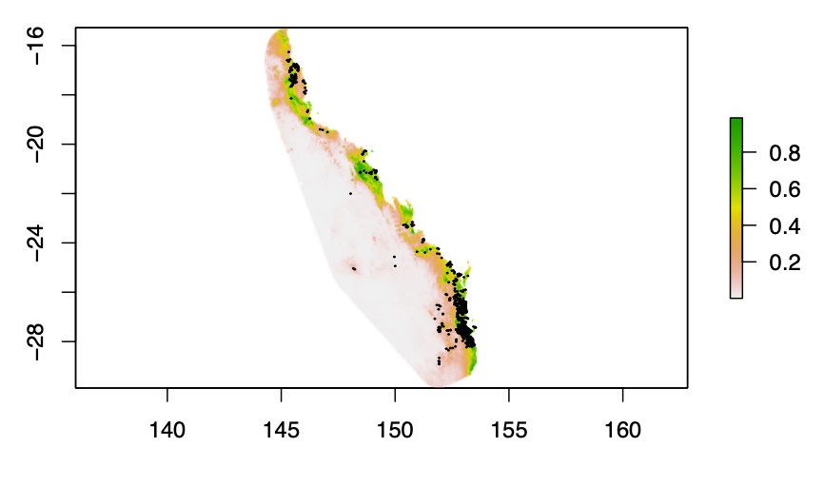
Step 3: Fit your model (results with bias layer)
map_predictions3 <- predict(Mod3_LiPe, LiPe_predictors)
Notes:
However, if you look up a distribution map of a species, it often shows a range rather than dots on a map. So, how do we go from specific places where individuals of a species have been observed to producing a map that gives an estimate of the distribution of that species? This is where species distribution models come into play.

Slide 18
Step 3: Fit your model (targeted background / zero filling)
zeros_1visit <- read.csv("data/LiPe_zero_locations_thinned_1vis.csv") # these are the locations where we assume there were no LiPe in that cell because at least one survey did not record our target species
x_bk2<- zeros_1visit$Long
y_bk2<-zeros_1visit$Lat
xy_bk2<-cbind(x_bk2,y_bk2)
xy.sp_bk2<-SpatialPoints(xy_bk2)
crs(xy.sp_bk2) <- crs(LiPe_predictors)
crs(xy.sp_bk2)
maxent_args <- c('removeduplicates=TRUE','jackknife=TRUE','responsecurves=TRUE', 'outputformat=cloglog','plots=TRUE')
Mod4_LiPe <- dismo::maxent(x=LiPe_predictors, p=xy.sp_LiPe, a=xy.sp_bk2, path = "results4", args= maxent_args)
Notes:
However, if you look up a distribution map of a species, it often shows a range rather than dots on a map. So, how do we go from specific places where individuals of a species have been observed to producing a map that gives an estimate of the distribution of that species? This is where species distribution models come into play.

Slide 19
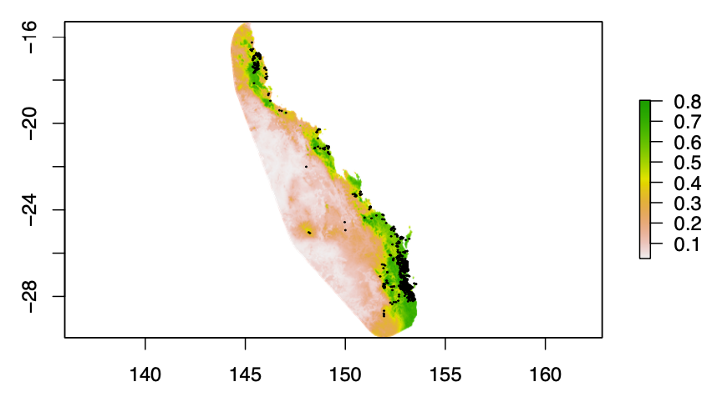
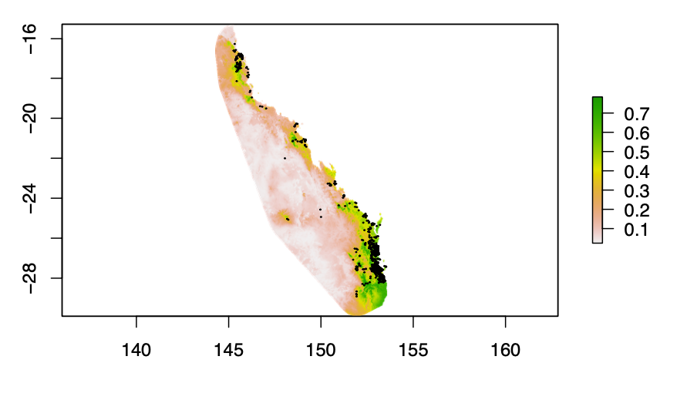
Step 3: Fit your model (targeted background & future predictions)
map_predictions4 <- predict(Mod4_LiPe, LiPe_predictors)
plot(map_predictions5)
points(xy.sp_LiPe,pch=20,cex=0.2)
setwd("~/Documents/Use_cases/SDM_in_R/predictors_future")
rast_lst2 <- list.files(pattern='.asc$', all.files=TRUE)
rast_lst2
LiPe_predictors_future <- stack(rast_lst2)
map_predictions5 <- predict(Mod4_LiPe, LiPe_predictors_future)
plot(map_predictions5)
points(xy.sp_LiPe,pch=20,cex=0.2)
Notes:
However, if you look up a distribution map of a species, it often shows a range rather than dots on a map. So, how do we go from specific places where individuals of a species have been observed to producing a map that gives an estimate of the distribution of that species? This is where species distribution models come into play.

Slide 20
Step 3: Fit your model (select areas w/ 3 visits & thinned data)
LiPe_zero_3vis<-read.csv("data/LiPe_zero_locations_3vis.csv")
head(LiPe_zero_3vis)
LiPe_zero_3vis$X <- NULL
LiPe_zero_3vis$spp <- NULL
head(LiPe_zero_3vis)
LiPe_thin <- as.data.frame(cbind(Long = LiPe_thinned$decimalLongitude, Lat = LiPe_thinned$decimalLatitude, pres = LiPe_thinned$layer))
LiPe_thin2 <- LiPe_thin[complete.cases(LiPe_thin), ]
head(LiPe_thin2)
LiPe_p_a <- rbind(LiPe_zero_3vis,LiPe_thin2)
xy.sp_pa<-SpatialPoints(xy_pa)
Notes:
However, if you look up a distribution map of a species, it often shows a range rather than dots on a map. So, how do we go from specific places where individuals of a species have been observed to producing a map that gives an estimate of the distribution of that species? This is where species distribution models come into play.

Slide 21
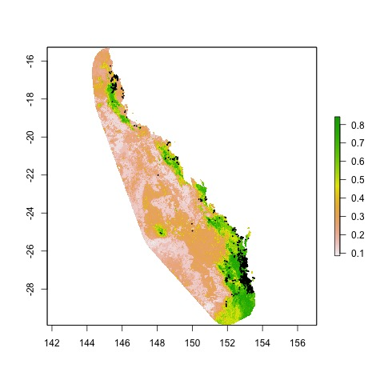
Step 3: Fit your model (BRT)
LiPe_preds <- extract(LiPe_predictors,xy.sp_pa)
LiPe_preds2 <- cbind(LiPe_p_a,LiPe_preds)
LiPe_preds3 <- as.data.frame(LiPe_preds2[complete.cases(LiPe_preds2), ])
LiPe_mod5_brt <- gbm.step(data = LiPe_preds3, gbm.x = c(4:9), gbm.y = 3, family = "bernoulli", tree.complexity = 3, learning.rate = 0.01, bag.fraction = 0.75)
names(LiPe_mod5_brt)
LiPe_mod5_brt$gbm.call
pred_map_brt <- predict(LiPe_predictors,
LiPe_mod5_brt,type = "response")
LiPe_mod5_brt$gbm.call$best.trees
plot(pred_map_brt)
Notes:
However, if you look up a distribution map of a species, it often shows a range rather than dots on a map. So, how do we go from specific places where individuals of a species have been observed to producing a map that gives an estimate of the distribution of that species? This is where species distribution models come into play.

Slide 22
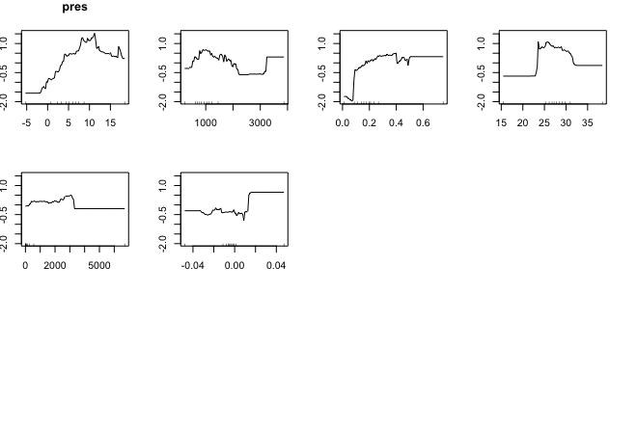
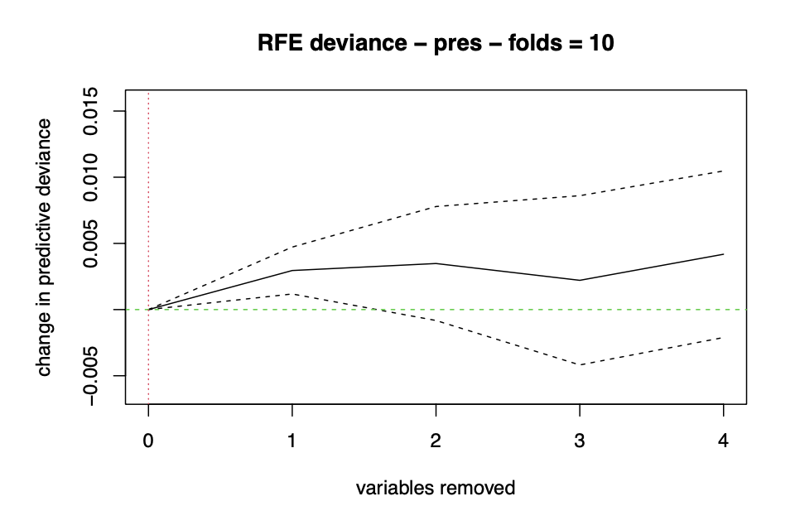
Step 3: Fit your model (exploring BRT model object)
# curious what a function does
??gbm.plot
gbm.plot(LiPe_mod5_brt,rug=TRUE) #response curves
gbm.plot.fits(LiPe_mod5_brt) #plots fitted values
gbm.interactions(LiPe_mod5_brt) # produces matrix on strength of interactions
BRT_var_import<-as.data.frame(LiPe_mod5_brt$contributions) # relative influence
brt_drops <- gbm.simplify(LiPe_mod5_brt, n.drops = 4) # indicates how many variables should be dropped
names(LiPe_preds3)[brt_drops$pred.list[[1]]]
names(LiPe_preds3)[c(4:9)]
names(LiPe_preds3)[brt_drops$pred.list[[2]]]
https://doi.org/10.1111/j.1365-2656.2008.01390.x
https://rspatial.org/raster/sdm/9_sdm_brt.html
Notes:
However, if you look up a distribution map of a species, it often shows a range rather than dots on a map. So, how do we go from specific places where individuals of a species have been observed to producing a map that gives an estimate of the distribution of that species? This is where species distribution models come into play.

Slide 23
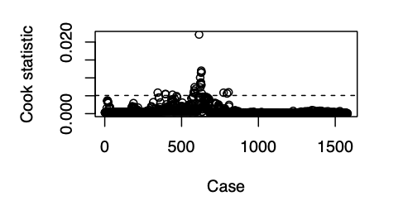
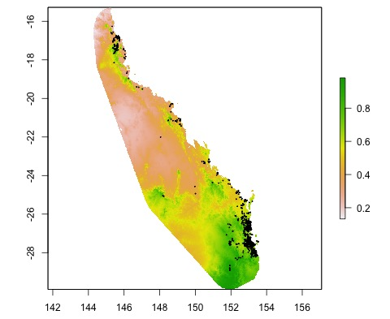
Step 3: Fit your model (cont.)
glm1<- glm(pres ~ AWAP + Bioclim05 + Bioclim06 + Bioclim12 + EVI+ wetland_connectivity, family = binomial, data = LiPe_preds3)
glm1
summary(glm1) # coefficient estimates & errors
glm1a <- step_BIC(glm1) # one way to select variables
model_diags <- glm.diag(glm1a) #residual diagnostics
glm.diag.plots(glm1a,model_diags)
names(LiPe_predictors)
LiPe_preds_subset <- LiPe_predictors[[which(c(TRUE,TRUE,TRUE,FALSE,FALSE,FALSE))]]
glm_pred <- predict(LiPe_preds_subset,glm1a,type="response")
plot(glm_pred)
Notes:
However, if you look up a distribution map of a species, it often shows a range rather than dots on a map. So, how do we go from specific places where individuals of a species have been observed to producing a map that gives an estimate of the distribution of that species? This is where species distribution models come into play.

Slide 24

Step 3: Fit your model (cont.)
gam1<- gam(pres ~ s(AWAP, bs="cr") + s(Bioclim05, bs="cr") + s(Bioclim06,bs="cr"), family = binomial, data = LiPe_preds3)
gam.check(gam1)
AIC(glm1a)
AIC(gam1)
plot(gam1)
gam_pred <- predict(LiPe_preds_subset,gam1,type="response")
Notes:
However, if you look up a distribution map of a species, it often shows a range rather than dots on a map. So, how do we go from specific places where individuals of a species have been observed to producing a map that gives an estimate of the distribution of that species? This is where species distribution models come into play.

Slide 25

We would welcome your feedback
To learn basics of R coding
https://datacarpentry.org/R-ecology-lesson/
Press feedback button to tell us what changes you want & to highlight anything that is not working.
https://www.ecocommons.org.au/
Use Cases
Educational Material
Notes:
You can find out more about EcoCommons on our webpage: ecocommons.org.au.
To raise awareness of the current extinction crisis, we launched our webpage on Threatened Species Day which remembers the extinction of the Tasmanian tiger (Thylacinus cynocephalus) in 1936. EcoCommons is committed to help researchers and policy-decision makers stop further extinctions by empowering them with data and analytics to do better informed management of Australia’s 1900+ threatened species.
On our webpage you can find out:
How you can become an EcoCommons Pioneer and be the first to explore and test new tools!
Follow our journey - sign up for our newsletter
Follow us on twitter or LinkedIn: @EcoCommonsAus
Collaborate with us!

Slide 26
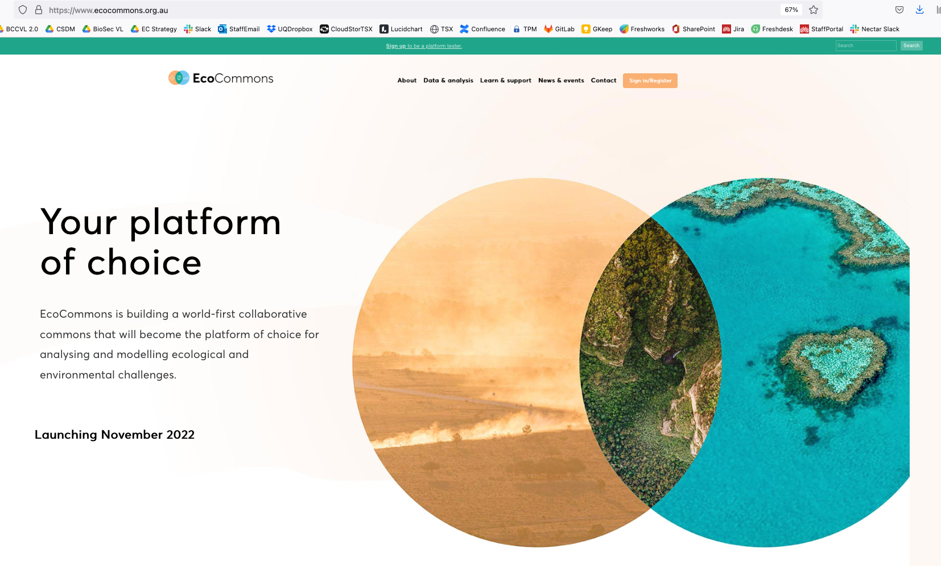
Explore EcoCommons webpage
Follow our Journey
https://www.ecocommons.org.au/
Notes:
You can find out more about EcoCommons on our webpage: ecocommons.org.au.
To raise awareness of the current extinction crisis, we launched our webpage on Threatened Species Day which remembers the extinction of the Tasmanian tiger (Thylacinus cynocephalus) in 1936. EcoCommons is committed to help researchers and policy-decision makers stop further extinctions by empowering them with data and analytics to do better informed management of Australia’s 1900+ threatened species.
On our webpage you can find out:
How you can become an EcoCommons Pioneer and be the first to explore and test new tools!
Follow our journey - sign up for our newsletter
Follow us on twitter or LinkedIn: @EcoCommonsAus
Collaborate with us!

Slide 27


We gratefully acknowledge:

Slide 28



Thank You

